Slide 2
Styling with CSS

Slide 3

What is CSS
CSS is a language for specifying how documents are presented to users — how they are styled, laid out, etc.

Slide 4
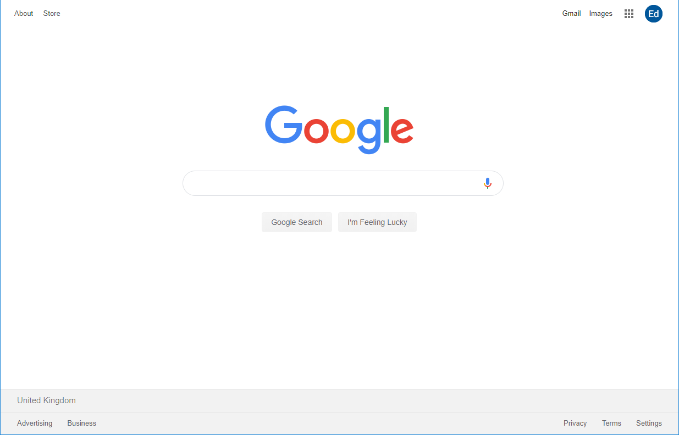
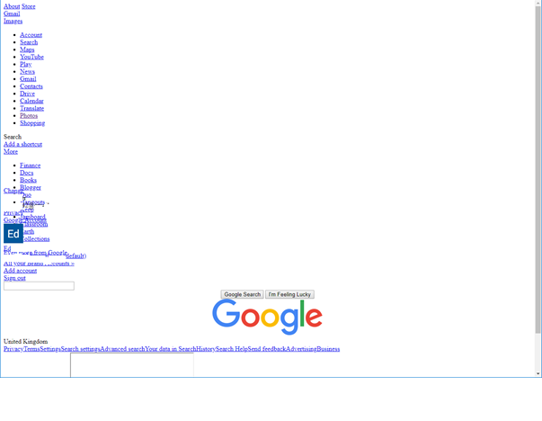
Comparison
With CSS
Without

Slide 5

Example
<!DOCTYPE html>
<html>
<head>
<meta charset="utf-8">
<title>My CSS experiment</title>
<link rel="stylesheet" href="style.css">
</head>
<body>
<h1>Hello World!</h1>
<p>This is my first CSS example</p>
</body>
</html>
h1 {
color: blue;
background-color: yellow;
border: 1px solid black;
}
p {
color: red;
}

Slide 6

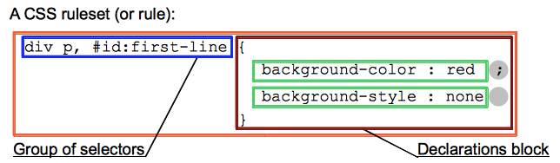

Slide 7

How to apply CSS
External (preferred)
Internal
Inline

Slide 8

Internal example
<!DOCTYPE html>
<html>
<head>
<meta charset="utf-8">
<title>My CSS experiment</title>
<style>
h1 {
color: blue;
background-color: yellow;
border: 1px solid black;
}
p {
color: red;
}
</style>
</head>
<body>
<h1>Hello World!</h1>
<p>This is my first CSS example</p>
</body>
</html>

Slide 9
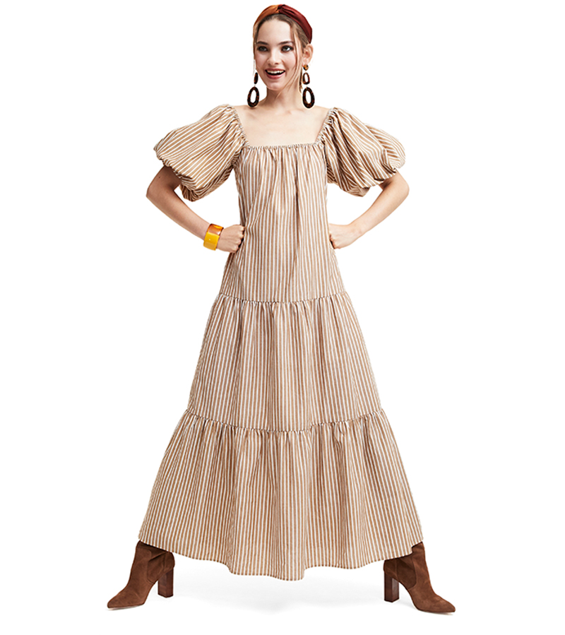
Inline example
<!DOCTYPE html>
<html>
<head>
<meta charset="utf-8">
<title>My CSS experiment</title>
</head>
<body>
<h1 style="color: blue;background-color: yellow;border: 1px solid black;">Hello World!</h1>
<p style="color:red;">This is my first CSS example</p> </body>
</html>

